Slide 1

PYTHON PROGRAMMING

Slide 2

INTRODUCTION
Python is a high-level, interpreted programming language known for its simplicity and readability.
Developed by Guido van Rossum and first released in 1991.
WHY PYTHON ?
Python works on different platforms (Windows, Mac, Linux, Raspberry Pi, etc).
Used for web development, data analysis, artificial intelligence, scientific computing, and more.
Comes with many modules and libraries that simplify coding tasks.
Python runs on an interpreter system, meaning that code can be executed as soon as it is written.
Python can be treated in a procedural way, an object-oriented way or a functional way.

Slide 3
PYTHON SYNTAX
Python syntax can be executed by writing directly in the Command Line as follows:
>>> print(“Hello, World!”)
Hello, World!
Or by creating a python file on the server, using the .py file extension, and running it in the Command Line:
C: \Users\Cognizant>python myfile.py

Slide 4
INDENTATION
Indentation refers to the spaces at the beginning of a code line.
Python uses indentation to indicate a block of code.
Ex:
if 5 > 2: print("Five is greater than two!")
O/P: Five is greater than two!
Python will give you an error if you skip the indentation.
Ex:
if 5 > 2: print("Five is greater than two!")
O/P: IndentationError: expected an indented block

Slide 5
VARIABLES AND COMMENTS
In Python, variables are created when you assign a value to it. Python has no command
for declaring a variable.
Example:
x = 5 y = "Hello, World!”
Comments start with a #, and Python will render the rest of the line as a comment.
Example:
#This is a comment. print("Hello, World!")

Slide 6
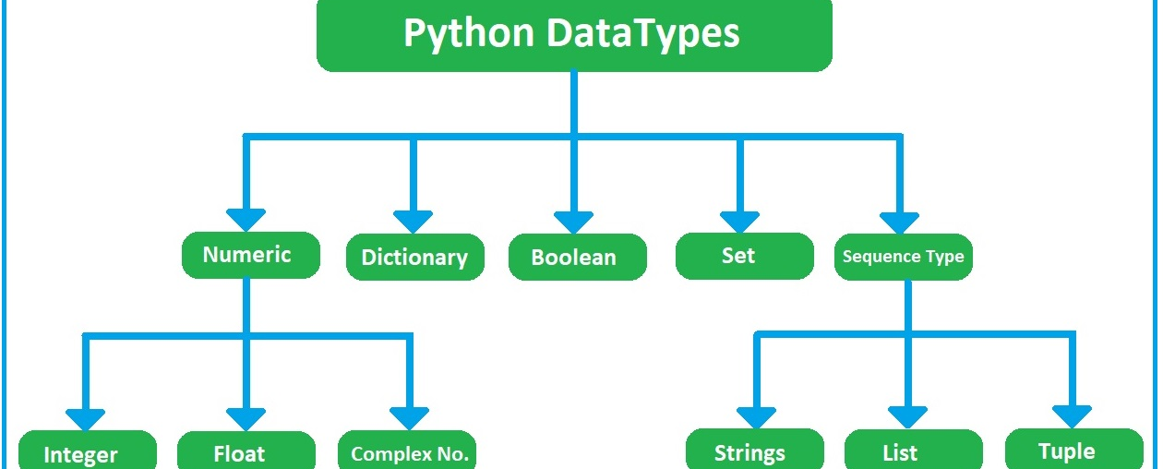
PYTHON DATATYPES

Slide 7
DATATYPES - OVERVIEW
Integers: Whole numbers, positive or negative, without decimals.
Ex: age = 25
Floats: Numbers that contain decimals.
python
Ex: pi = 3.14
Strings: Sequences of characters enclosed in quotes.
python
Ex: name = "Alice"
Booleans: Represent true or false values.
python
Ex: is_student = True

Slide 8
Lists: Ordered collections of items (which can be of different types) enclosed in square brackets.
Ex: fruits = ["apple", "banana", "cherry"]
Tuples: Ordered, immutable collections of items enclosed in parentheses.
Ex: coordinates = (10.0, 20.0)
Dictionaries: Collections of key-value pairs enclosed in curly braces.
Ex: person = { "name": "Alice", "age": 25, "city": "New York" }
Sets: Unordered collections of unique items enclosed in curly braces.
Ex: unique_numbers = {1, 2, 3, 4, 5}

Slide 9
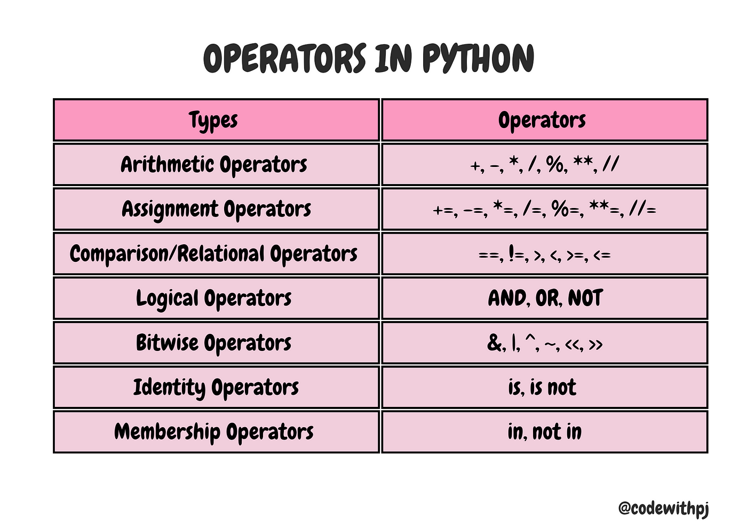
OPERATORS

Slide 10
DECISION MAKING
Sr.No. | Statement & Description
1 | if statements An if statement consists of a boolean expression followed by one or more statements.
2 | if...else statements An if statement can be followed by an optional else statement, which executes when the boolean expression is FALSE.
3 | nested if statements You can use one if or else if statement inside another if or else if statement(s).

Slide 11
IF AND IF-ELSE SHORTHAND IF
if expression:
statement(s)
Ex: num = 8
if num > 0:
print("The number is positive.")
if expression:
statement(s)
else:
statement(s)
Ex: num = 11
if num % 2 == 0:
print("The number is even.")
else:
print("The number is odd.")
if a > b: print("a is greater than b")

Slide 12
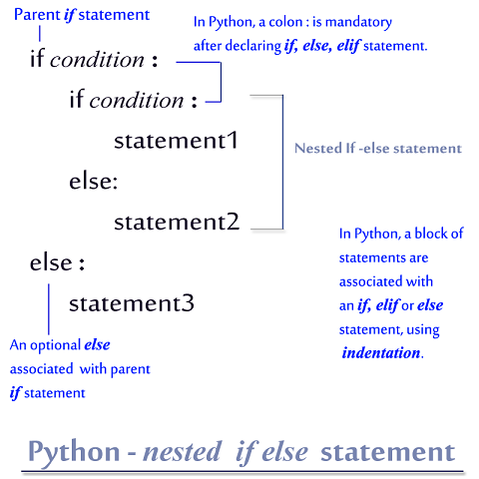
NESTED IF-ELSE
num = 3
if num > 0:
if num % 2 == 0:
print("The number is positive and even.")
else:
print("The number is positive but odd.")
else:
print("The number is not positive.")

Slide 13
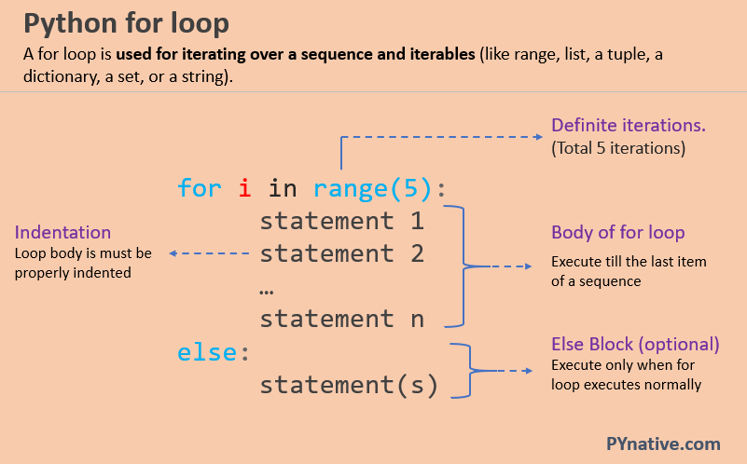
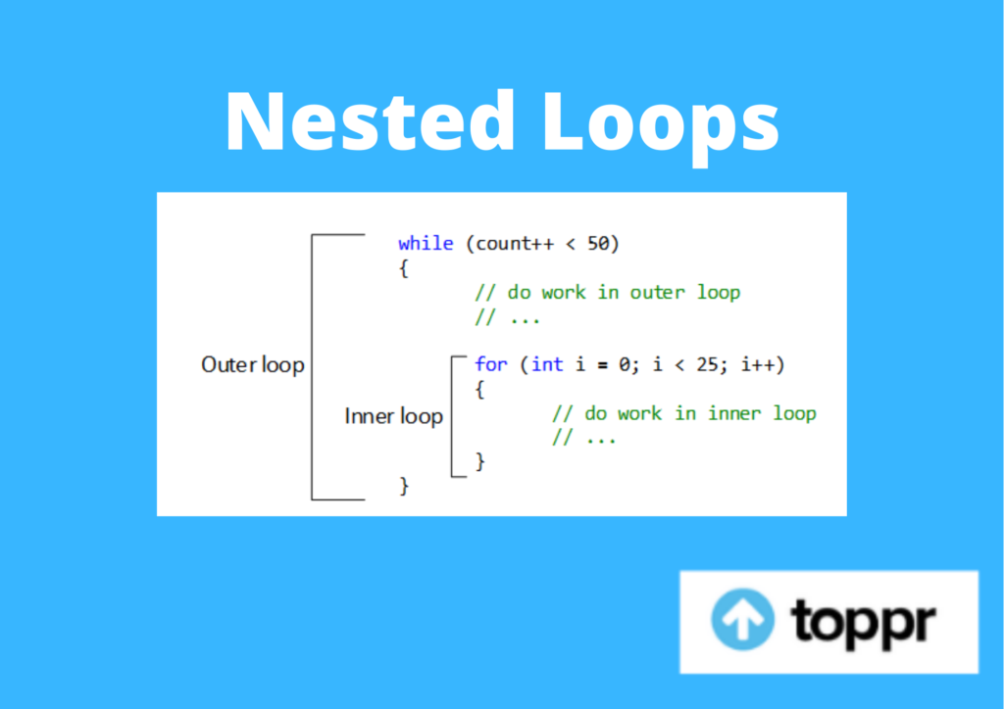
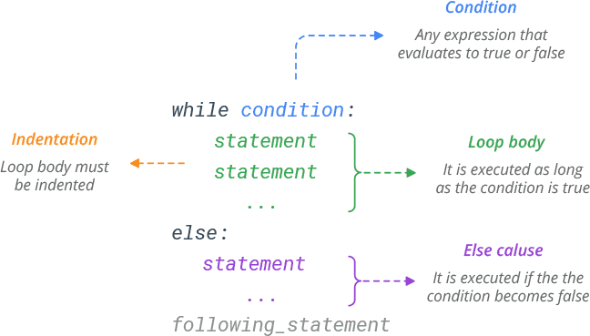
LOOPING STATEMENTS

Slide 14
FUNCTIONS
In Python a function is defined using the def keyword.
def my_function(): print("Hello from a function")
To call a function, use the function name followed by parenthesis.
def my_function(): print("Hello from a function") my_function()

Slide 15
MODULES
CREATE MODULE
mymodule.py
def greeting(name): print("Hello, " + name)
USE MODULE
import mymodule mymodule.greeting("Jonathan")
BUILT-IN MODULES
import platform x = platform.system() print(x)
RENAMING A MODULE
import mymodule as mx a = mx.person1["age"] print(a)

Slide 16
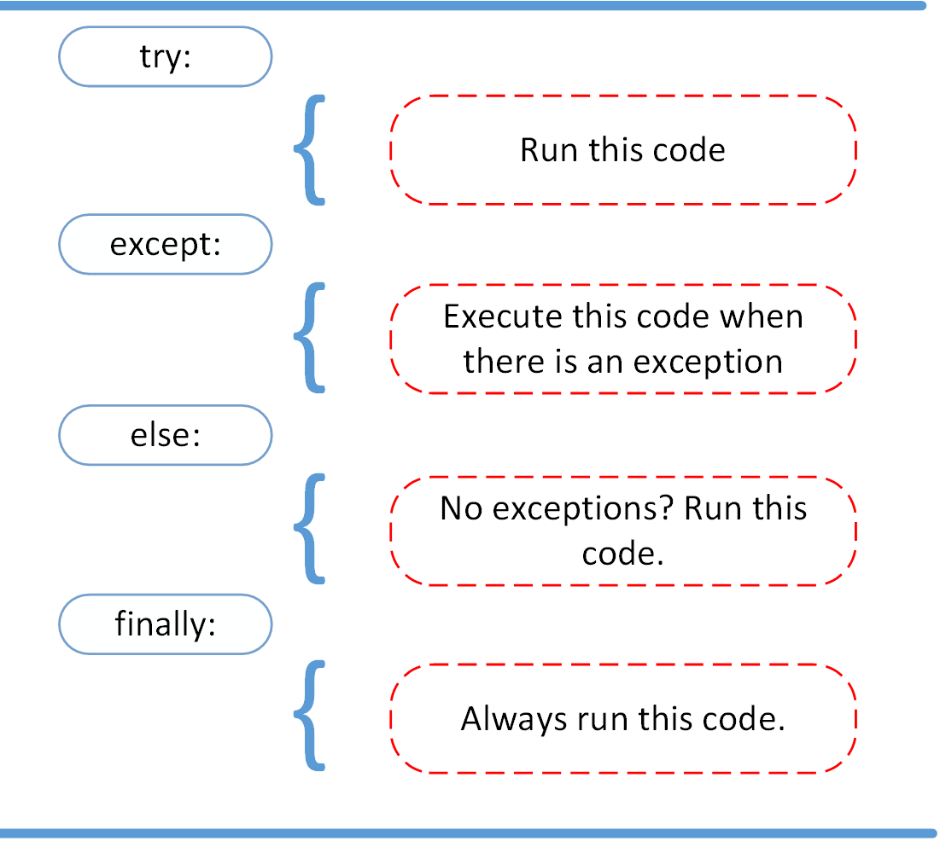
EXCEPTION HANDLING

Slide 17
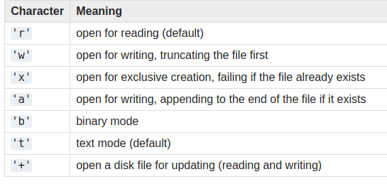
FILE HANDLING

Slide 18
Opening a File:
file = open("example.txt", "r")
Reading from a File:
content = file.read()
print(content)
readline() method reads one line at a time.
line = file.readline()
print(line)
readlines() method reads all lines and returns them as a list.
lines = file.readlines()
print(lines)

Slide 19
Writing to a File:
file = open("example.txt", "w")
file.write("Hello, World!")
file.close()
Appending to a File:
file = open("example.txt", "a")
file.write("\nAppended text.")
file.close()
Closing a File:
file.close()
Using the with Statement:
The with statement ensures that the file is properly closed after its operation finishes.
with open("example.txt", "r") as file:
content = file.read()
print(content)

